Slide 1
Is Gun Control Effective?
By Fauzan Amjad

Slide 2
Background Information
We’re given a rich dataset with both categorical and quantitative data allowing us to run a variety of statistical models on it.
Categorical data values include weapons used, the type of gun law in place at the time, the moon phase, and weather.
The quantitative data that’ll assist a lot is monetary damage inflicted by the weapon.
We want to be able to determine from this data whether gun control is effective or not.
Let’s do a permutation test.

Slide 3
Null Hypothesis and Alternate Hypothesis
Null Hypothesis: The robberies in locations with strict gun laws in place have the same monetary damages as the robberies in locations with loose gun laws in place.
Alternate Hypothesis: The robberies in locations with strict gun laws in place have different monetary damages as the robberies in locations with loose gun laws in place.
If we manage to accept to alternate hypothesis, the statistical test can be used as evidence to illustrate how gun control is effective.

Slide 4
We Assume the Null Hypothesis to Be True

Slide 5
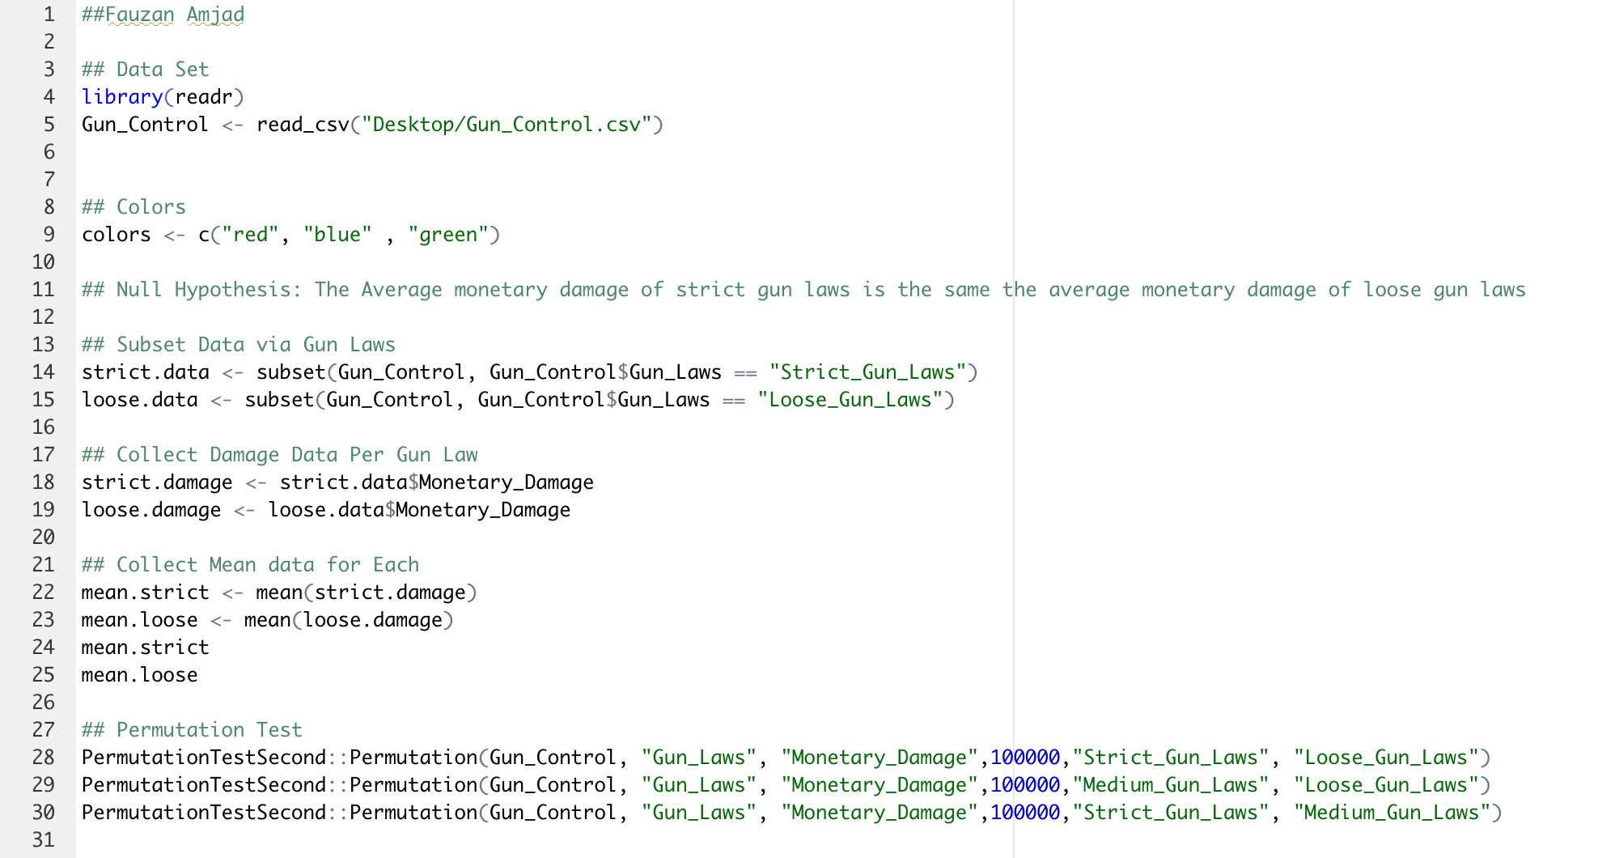

Slide 6
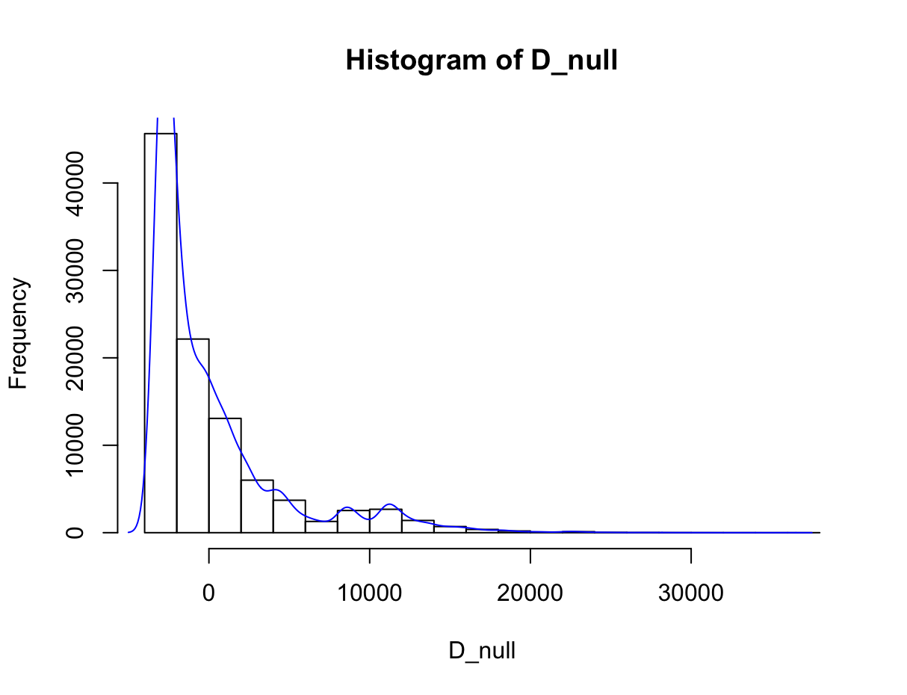
The Result of Our Permutation Test
We’ve attained a
p-value of 0.

Slide 7
Permutation Test Interpretation
The calculated p-value derived from our Permutation Test will be used as our evidence against the null hypothesis.
We’ll use 0.05 as our threshold to either reject the null hypothesis or fail to reject the null hypothesis.
The p-value I got was 0.
0 is less than the 0.05 threshold we established.

Slide 8

We reject the null hypothesis. We can conclude with a high degree of certainty that the alternative hypothesis is true.

Slide 9
Trying to Prove that Gun Control is Not Effective
Extra Credit

Slide 10
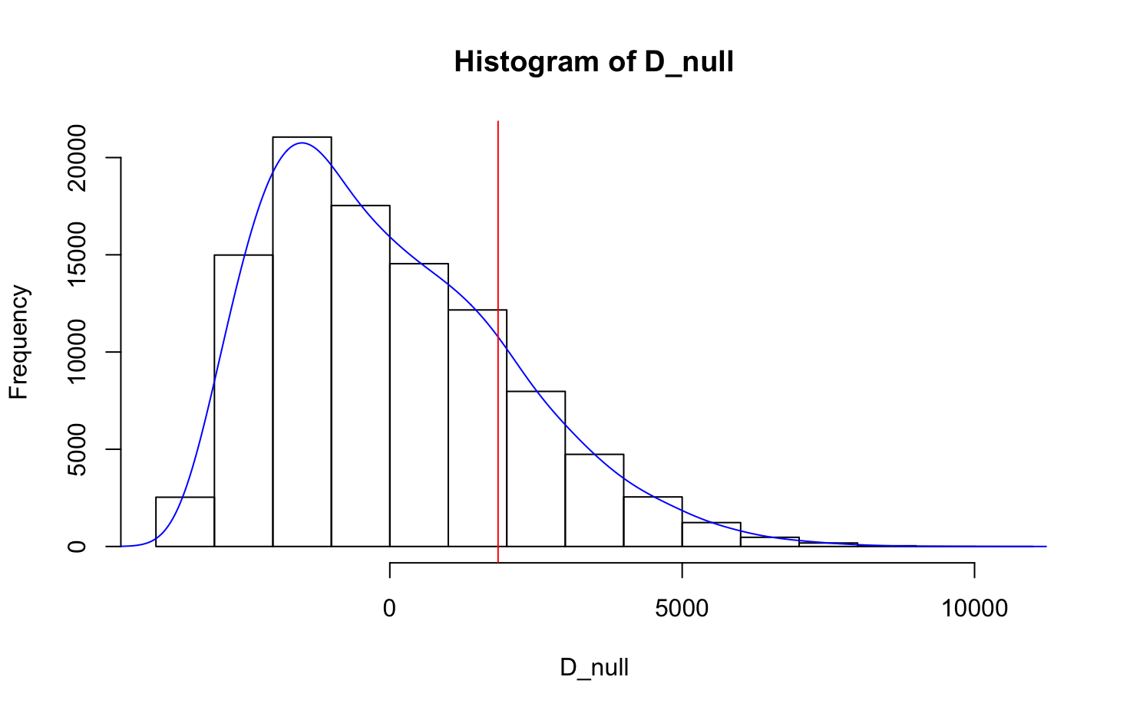
Evidence 1
Null Hypothesis: The robberies in locations with strict gun laws in place have the same monetary damages as the robberies in locations with medium gun laws in place.
Alternate Hypothesis: The robberies in locations with strict gun laws in place have different monetary damages as the robberies in locations with medium gun laws in place.
P-Value Threshold: 0.05
P-Value Calculated: 0.18776
Conclusion: We fail to reject the null hypothesis. Therefore, we can consider, not conclude, that increasing gun control does not change monetary damage

Slide 11
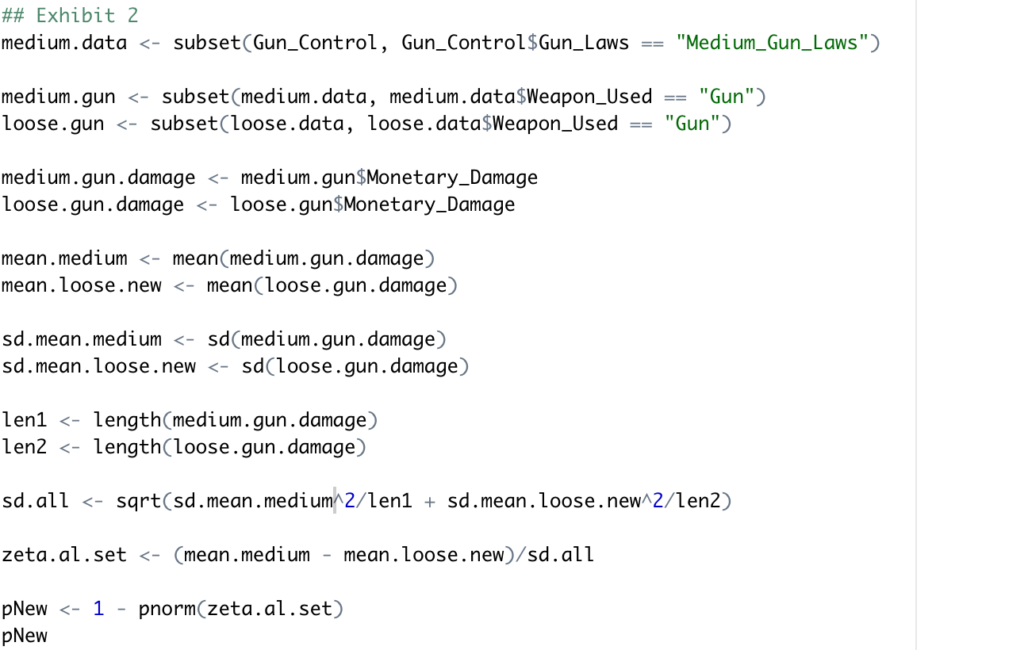
Evidence 2
Null Hypothesis: The robberies with GUNS in locations with medium gun laws in place have the same monetary damages as the robberies with GUNS in locations with loose gun laws in place.
Alternate Hypothesis: The robberies with GUNS in locations with medium gun laws in place have different monetary damages as the robberies with GUNS in locations with loose gun laws in place.
P-Value Threshold: 0.05
P-Value Calculated: 0.99
Conclusion: We fail to reject the null hypothesis. Therefore, the monetary damage by GUNS is the same regardless of medium or loose gun laws.

Slide 12
Evidence 3
WE DON’T HAVE ENOUGH LOOSE GUN LAW DATA!!!

